Slide 1
A Machine Learning Approach to predict Gender, Age and Emotion by extracting statistical features from Frequency Spectrum Analysis of speech
Group no: B15
Thesis Members:
Dipan Sadekeen - 201714020
M Aqib Alfaz - 201714024
Syed Rohit Zaman - 201714060
Thesis Supervisor:
Dr. Rifat Shahriyar
Associate Professor, CSE, BUET
Email: rifat.shahriyar@gmail.com

Slide 2


Broad Area of Research
Frequency Spectrum Analysis
Machine Learning

Slide 3
Introduction
Speech is a medium of communication to exchange information from one speaker to one or more listeners.
In speech processing, speech is transformed into electrical signals, volt-ages, or currents, in which form typically speech signals can be analyzed.
The frequency spectrum analysis of the signal is called the analysis of the amplitude, frequency, and phase of the audio signals.
Frequency
Spectrum
Analysis
Audio Signal
Dataset
Dataset is essential for building Machine Learning Models

Slide 4
Introduction (Cont.)
Frequency Spectrum Analysis can be used for extracting features from any audio files. On this research, 20 statistical features were extracted from each audio and those are :
Mean Frequency | Q75 | Spectral Entropy | Mean Fundamental Frequency | Minimum Dominant Frequency
SD(standard deviation), | IQR | Spectral Flatness | Minimum Fundamental Frequency | Maximum Dominant Frequency
Median | Skewness | Mode | Maximum Fundamental Frequency | Dominant Frequency
Q25 | Kurtosis | Centroid | Mean Dominant Frequency | Modulation Index

Slide 5
Introduction (Cont.)
Gender, age, and emotion detection from the speech are essential in machine and human interaction. Several researchers have focused on detecting gender, age,and emotion from different types of sources. But according to the best of our knowledge, none of them use a single type of source to detect all of them. We have introduced a system to detect gender, age, and emotion from speech.
This research will help for
Effectiveness of Frequency Spectrum Analysis in order to detect gender, age and emotion
Categorizing audios by age and gender from speech,
Investigation purposes,
Predicting customer demographic segment,
Recommending offers,
Telecommunication industries need to analyze their audio calls

Slide 6
Literature Review
From many papers those we had read some are included here with brief description which was our main concern in case of our thesis purpose.
Key Feature | Reference | Summary
Gender Detection | Ramdinmawii et al. [10] | Conducted a study to predict gender from Pitch’s speech using Auto-Correlation, Signal Energy, Mel Frequency Cepstral Coefficients (MFCC), and SVM classifiers.
 | Djemili et al. [6] | Conducted a study to predict gender from speech using GMM,Multilayer Perceptron (MLP), Vector Quantization (VQ), and Learning Vector Quantization (LVQ).
Age Detection | Bahari et al. [7] | Conducted a study to predict age with Generalized Regression Neural Network (GRNN).
 | Pˇribil et al. [5] | Conducted a study to predict age from speech using Gaussian Mixture Modelling (GMM).

Slide 7
Literature Review (Cont.)
Key Feature | Reference | Summary
Emotion Detection | Grosbras et al. [9] | Conducted a study to predict Emotion from speech using Multilayer Perceptron (MLP).
 | Wang et al. [8] | Conducted a study to predict emotion from speech using Deep Neural Networks (DNN).
Gender, age & Emotion Detection | Shafran et al. [4] | Conducted a study to predict gender, age, and emotion from speech using the Hidden Markov Model (HMM) and the Support Vector Machine (SVM).
Major Concerns From the existing papers:
There is no study in the literature to compare all the predictive models using supervised machine learning algorithms to measure comparative performance.
None of the approaches used Frequency Spectrum Analysis to detect gender, age and emotion .

Slide 8
Objectives
To develop a single approach for predicting gender, age and emotion from speech.
To explore the effectiveness of Frequency Spectrum Analysis for predicting gender, age and emotion from speech.
To compare the performance of the developed machine learning models and to find out the best machine learning model.

Slide 9
Methodology
Phase – I
Dataset Generation
Define Objectives
Literature Review
Audio Data Collection
Feature Extraction
Comparing Performance
Developing ML Models
Data Preparation
Phase – II
Analyze ML Algorithms
9

Slide 10
Phase – I : Dataset Generation (Audio Data Collection)
This study used the audio dataset of “Mozilla Common Voice” [2] to build prediction models for gender and age. The data set contains 64000 audio files in MP3 format with 61528 (Common voice corpus 5.1) different voices. The dataset also includes a CSV file containing filename, accent, age, gender, upvotes, and downvotes.
This study used the audio dataset of “Ryerson AudioVisual Database of Emotional Speech and Song (RAVDESS)” [3] to build prediction models for emotion which includes 7356 files. There are 24 professional actors in the database (12 female, 12 male). The speech includes expressions of calm, happiness, sadness, angry, fear, surprise, and disgust.

Slide 11
Phase – I : Dataset Generation (Labels of the datasets)
On the Mozilla audio dataset ,along with the audio files labels were also provided. Labels for the gender were male and female. For the Age provided labels were teens, twenties, thirties, forties, fifties, sixties, seventies, eighties, and nineties.
After the feature extraction the labels were categorized into 3 categories where young includes teens and twenties, the category matured includes thirties, forties, fifties, and the category old included sixties, seventies, eighties, nineties.
So In our thesis we work with Old, Mature and Young labels for the Age Dataset.

Slide 12
Phase – I : Dataset Generation (Labels of the datasets) (Cont.)
The speech file contains 1440 audio files. Each filename consists of a 7-part numerical identifier (e.g., 02-01-06-01-02-01-12.wav), where the third one from the left side denotes the emotion. If emotion is
01 = neutral,
02 = calm,
03 = happy,
04 = sad,
05 = angry,
06 = fearful,
07 = disgust,
08 = surprised.
In our thesis we work with only happy,sad,angry.labels for the emotion dataset.

Slide 13
Phase – I : Dataset Generation Phase – I : Generated Datasets
Mozilla[2]
Using
Excel
CSV(filename, gender, age)
Filtered CSV data
Labeled Final Dataset for Gender and Age
Using R
Audio (.Mp3)
Audio (.Wav)
FSA
Audio Feature Dataset
FSA
Ravdess[3]
Audio (.Wav)
Audio Feature Dataset
Labeled Final Dataset for Emotion
Using
R
Using
Excel
Audio Filename
Emotion Label

Slide 14
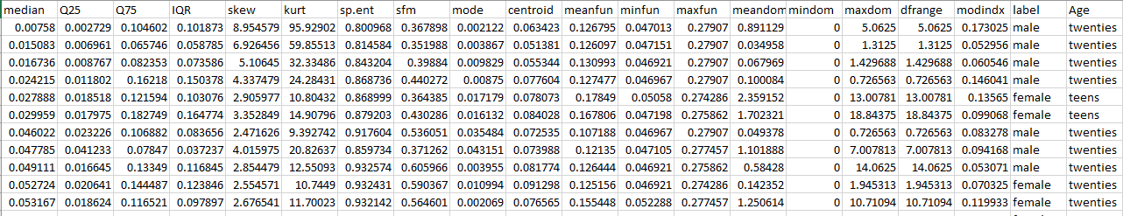
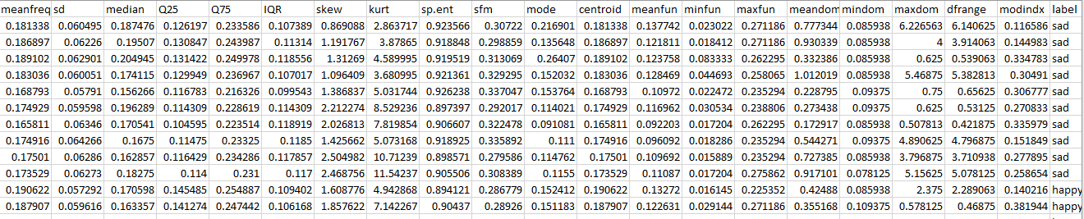
Phase – I : Generated Datasets Phase – II : Analyze ML Algorithms
Final Gender and Age Dataset:
Final Emotion Dataset:

Slide 15
Phase – II : Analyze ML Algorithms
Using Smote for solving class imbalance
Dataset
Handling Missing Values
Removing Outliers
Build 10 ML models
Analyse Important Features
Choose the best model comparing accuracy

Slide 16




Tools and Platform Used
For Dataset creation and Data Preprocessing : RStudio and Excel
For Developing Machine Learning Model: Google colab, Jupyter notebook.

Slide 17
Machine Learning Models
On each dataset, ten different machine learning algorithms were applied for predicting gender, age, and emotion to get the best predictive model among all models with the help of Python’s Scikit-learn library .The Predictive models are:
Random Forest
CatBoost
Gradient Boosting
K-nearest neighbors (KNN)
XGBoost
A comprehensive evaluation of all the machine learning models is done in terms of accuracy, precision, recall, and F1 score.
AdaBoost
Decision Tree
Artificial neural networks (ANN)
Naive Bayes
Support vector machine (SVM)

Slide 18
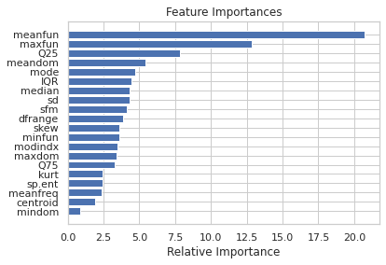
Results (Best 3 results for gender detection based on test accuracy)
Model | Accuracy (train) | Precision (train) | Recall (train) | F1_score (train) | Accuracy(test) | Precision(test) | Recall (test) | F1_score (test)
CATBOOST | 1 | 1 | 1 | 1 | 0.964 | 0.964 | 0.964 | 0.964
Gradient Boosting | 0.998 | 0.998 | 0.998 | 0.998 | 0.959 | 0.959 | 0.959 | 0.959
Random Forest | 1 | 1 | 1 | 1 | 0.958 | 0.958 | 0.958 | 0.958
For the CATBOOST :
Most Important feature: meanfun
Least important feature: mindom
(Among 20 statistical features)

Slide 19
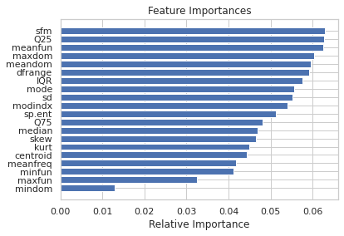
Results (Best 3 results for age detection based on test accuracy)
Model | Accuracy (train) | Precision (train) | Recall (train) | F1_score (train) | Accuracy(test) | Precision(test) | Recall (test) | F1_score (test)
Random Forest | 1 | 1 | 1 | 1 | 0.704 | 0.701 | 0.708 | 0.703
CATBOOST | 0.992 | 0.992 | 0.992 | 0.992 | 0.703 | 0.701 | 0.706 | 0.703
Gradient Boosting | 0.942 | 0.943 | 0.942 | 0.942 | 0.665 | 0.665 | 0.668 | 0.664
For the Random Forest :
Most Important feature: sfm, Q25, meanfun
Least important feature: mindom
(Among 20 statistical features)

Slide 20
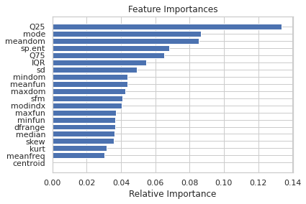
Results (Best 3 results for emotion detection based on test accuracy)
Model | Accuracy (train) | Precision (train) | Recall (train) | F1_score (train) | Accuracy(test) | Precision(test) | Recall (test) | F1_score (test)
XGBOOST | 0.89 | 0.892 | 0.89 | 0.89 | 0.661 | 0.667 | 0.66 | 0.66
CATBOOST | 1 | 1 | 1 | 1 | 0.64 | 0.64 | 0.641 | 0.64
Gradient Boosting | 1 | 1 | 1 | 1 | 0.64 | 0.642 | 0.64 | 0.64
For the XGBOOST :
Most Important feature: Q25
Least important feature: Centroid
(Among 20 statistical features)

Slide 21
Conclusion and Discussion
Several studies have focused on detecting gender, age,and emotion from different types of sources. But according to the best of our knowledge, none of them use a single type of source to detect all of them. We have introduced a system to detect gender, age, and emotion from speech.
Limitation
If the audio clips consisted of voices from more than one person simultaneously, it will not be able to find out the age, gender, or emotion of them within the provided accuracy.
Future Work
Detection of age, gender, and emotion from audio voices of multiple people. A web application to predict age, gender, and emotion.

Slide 22
References
[1] S. A. Fulop,Speech spectrum analysis.Springer Science & Business Media, 2011.
[2] Voice.mozilla.org,“common voice,”https://commonvoice.mozilla.org/en, 2021, accessed:2021-01-15.
[3] Smartlaboratory.org,“Ravdess—smartlab,”https://smartlaboratory.org/ravdess/, 2021, accessed: 2021-01-15.
[4] I. Shafran, M. Riley, and M. Mohri, “Voice signatures,” in 2003 IEEE Workshop on Automatic Speech Recognition and Understanding (IEEECat. No.03EX721), 2003, pp. 31–36.
[5] J. Pˇribil, A. Pˇribilov ́a, and J. Matouˇsek, “Gmm-based speaker gender and age classification after voice conversion,” in 2016 First International Workshop on Sensing, Processing and Learning for Intelligent Machines(SPLINE), 2016, pp. 1–5.
[6] E. Ramdinmawii and V. K. Mittal, “Gender identification from speech signal by examining the speech production characteristics,” in 2016 International Conference on Signal Processing and Communication(ICSC), 2016, pp. 244–249.

Slide 23
References (Cont.)
[7] R. Djemili, H. Bourouba, and M. C. A. Korba, “A speech signal based gender identification system using four classifiers,” in 2012 International Conference on Multimedia Computing and Systems, 2012, pp. 184–187.
[8] M. H. Bahari and H. Van Hamme, “Speaker age estimation and gender detection based on supervised non-negative matrix factorization,” in 2011 IEEE Workshop on Biometric Measurements and Systems for Security and Medical Applications (BIOMS), 2011, pp. 1–6.
[9] Z. Wang and I. Tashev, “Learning utterance-level representations for speech emotion and age/gender recognition using deep neural networks,”in2017 IEEE International Conference on Acoustics, Speech and Signal Processing (ICASSP), 2017, pp. 5150–5154.
[10] M.-H. Grosbras, P. D. Ross, and P. Belin, “Categorical emotion recognition from voice improves during childhood and adolescence,”Scientific reports, vol. 8, no. 1, pp. 1–11, 2018.

Slide 24
Thank You

